Slide 1
Adham Ashraf Saeed
Assignment 2 (Mapping & Normalization)

Slide 2
Problem 1
DreamHome Company is designed to connect individuals interested in renting properties with their owners. It’s important to note that the term ‘Rent’ refers to the value assigned to the property, determined through negotiation between the customer and the owner.
To achieve the (3NF) using the provided data begin by detailing the steps for your answer. The primary key should be the Customer number. Exclude the Page number and Date from the bill shown below.

Slide 3
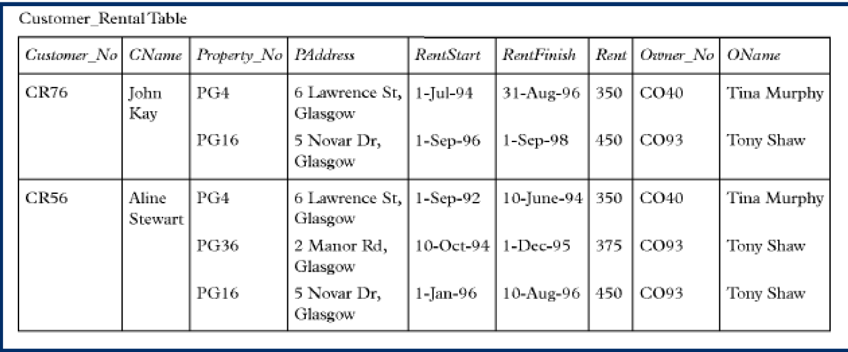
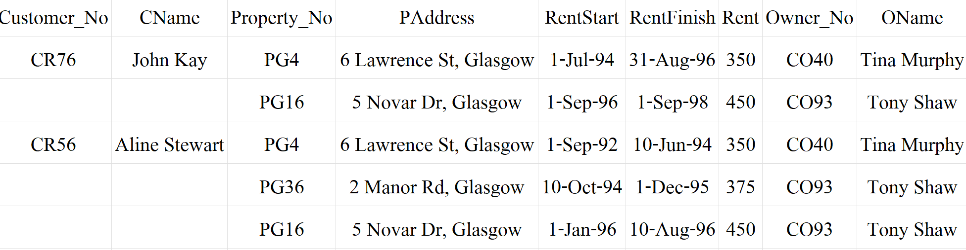
Data

Slide 4
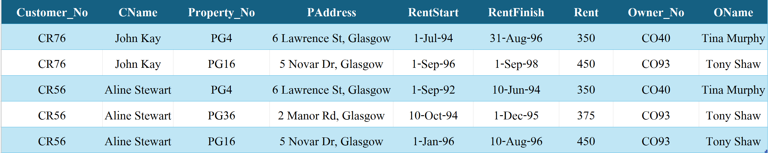
1NF

Slide 5
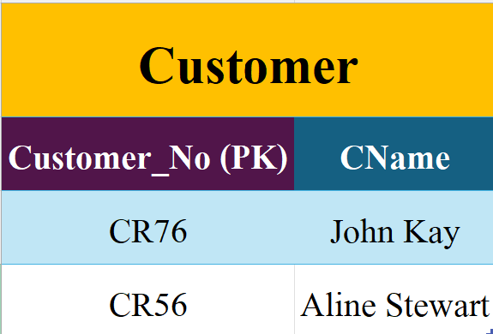
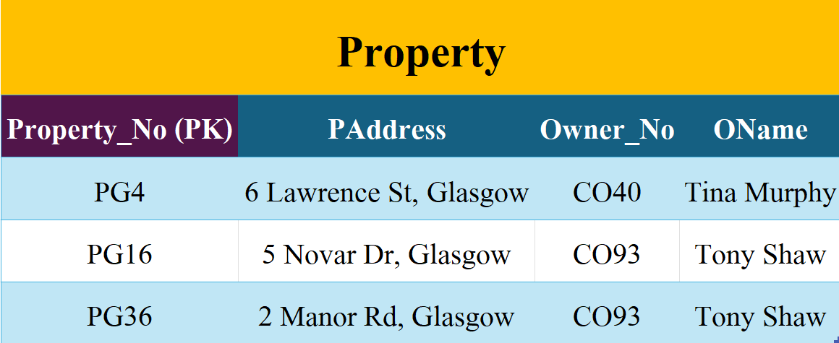
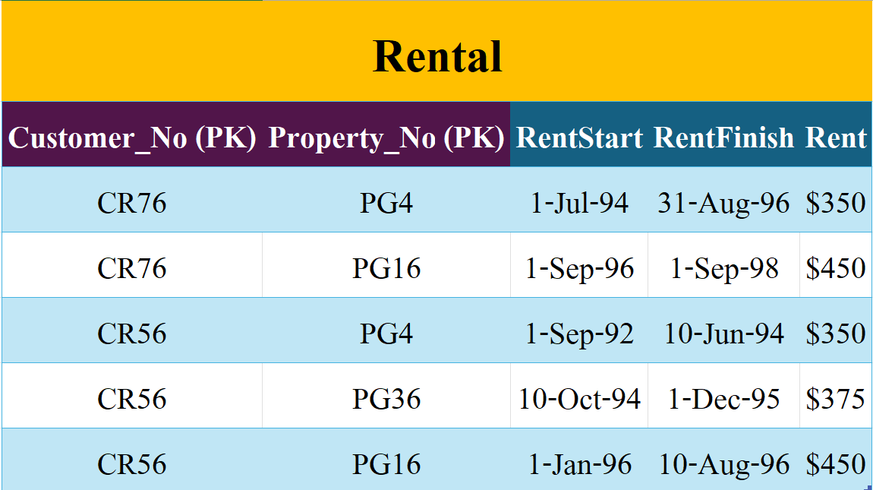
2NF

Slide 6
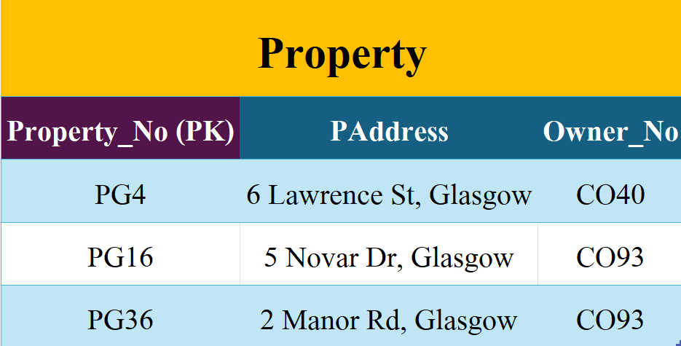
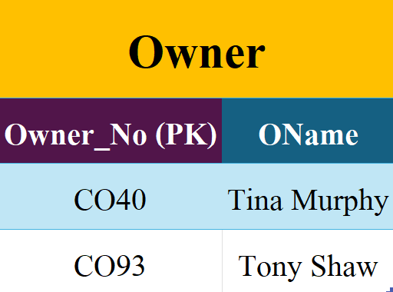
3NF

Slide 7
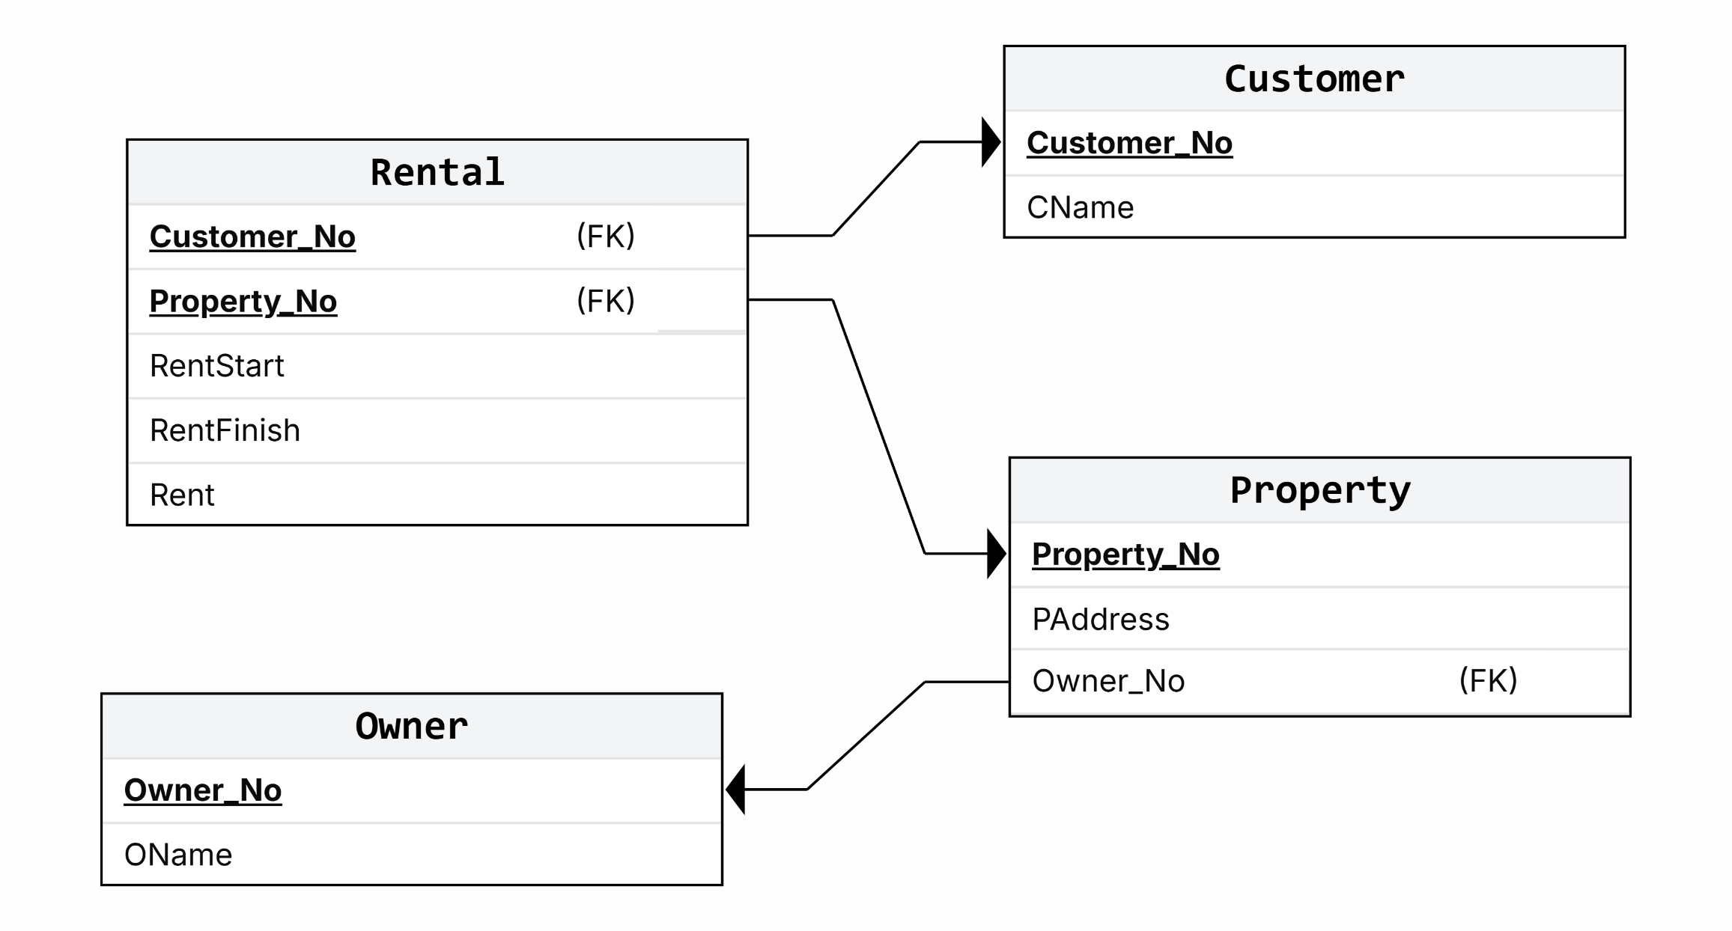
Mapping

Slide 8
Problem 2
The provided report contains detailed information concerning the organization's projects and the employees assigned to them. The records illustrate a many-to-many relationship: a project can involve multiple employees, and an employee can work on multiple projects. Additionally, each job classification is associated with a specific hourly charge rate (CHG/Hour). Your task is to apply the First, Second, and Third Normal Forms (1NF, 2NF, and 3NF) to this data.

Slide 9
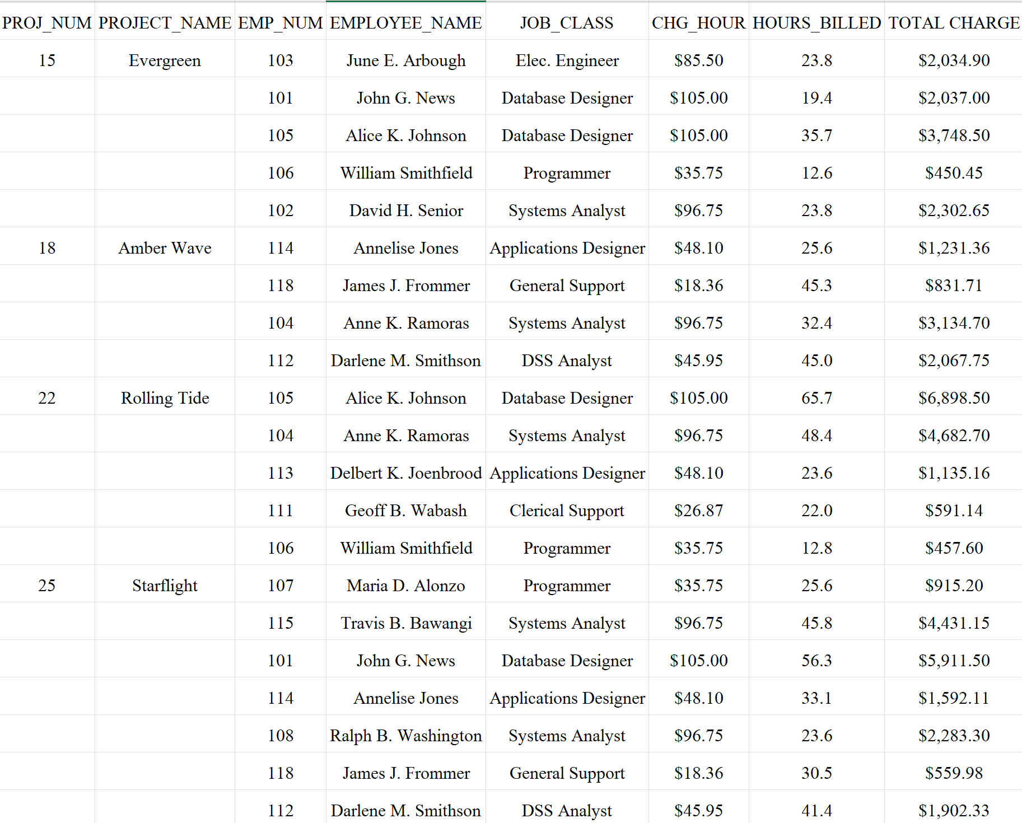
Data

Slide 10
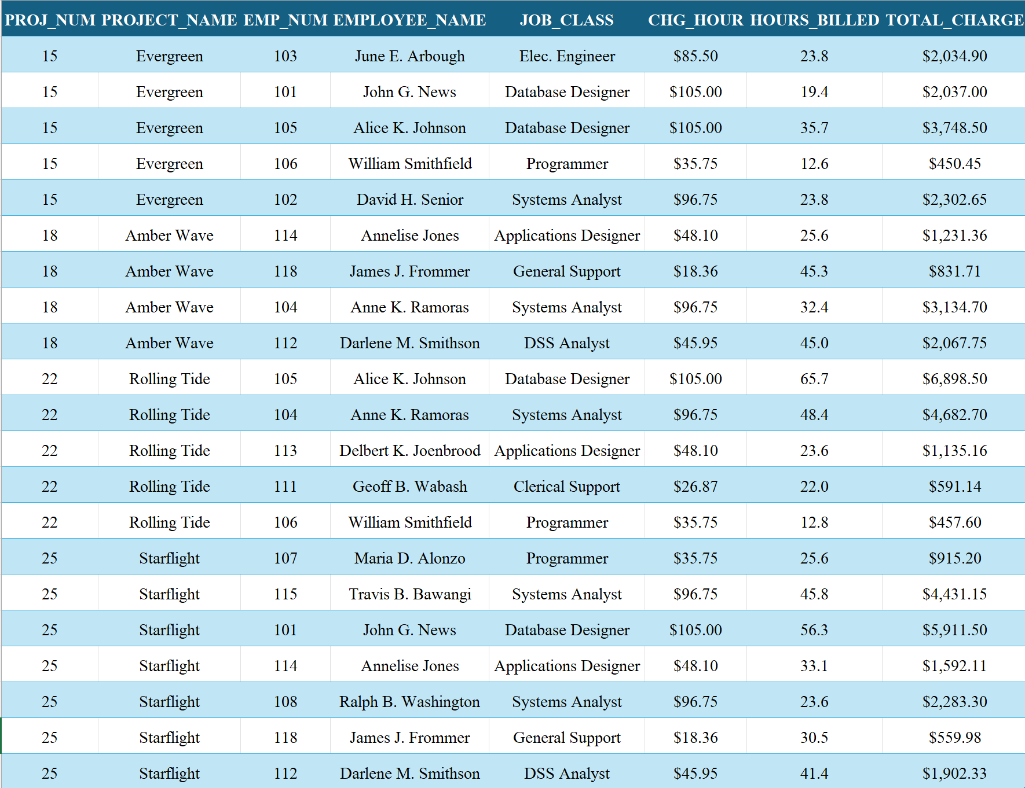
1NF

Slide 11
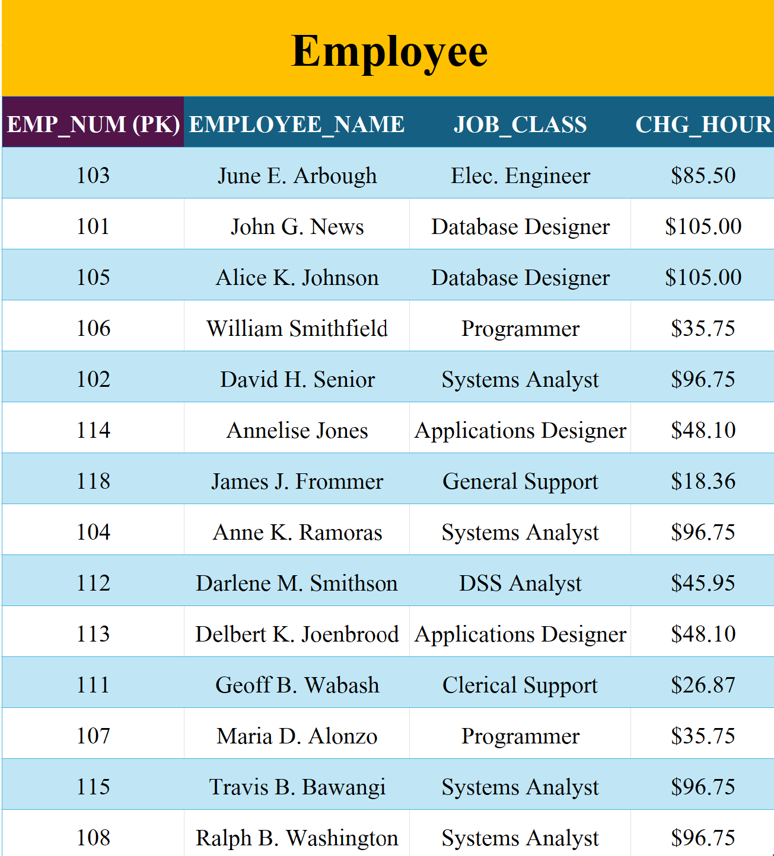
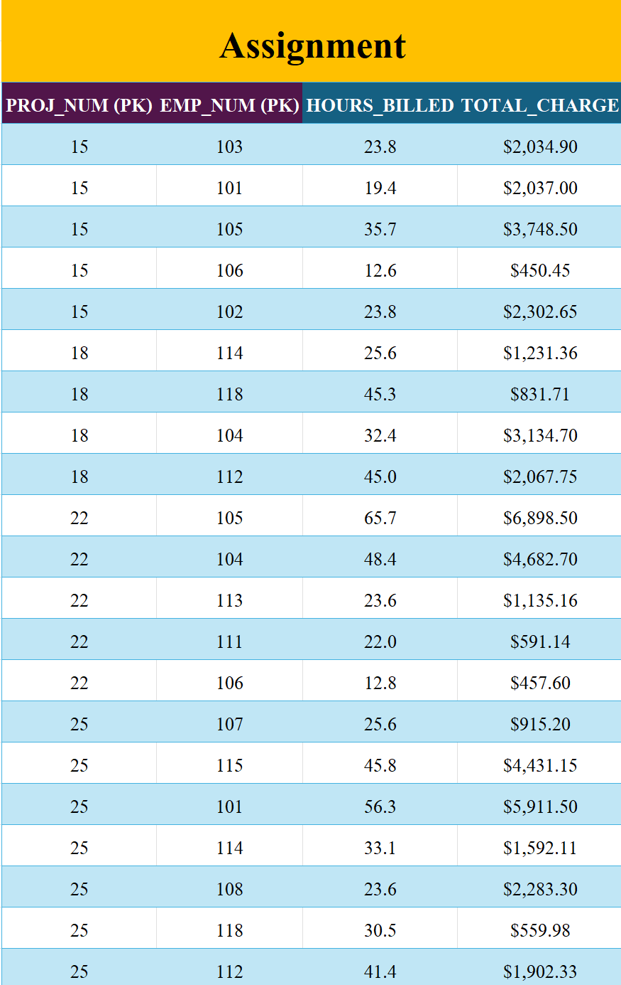
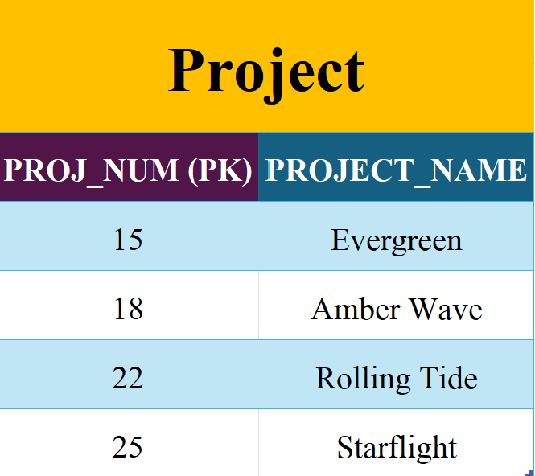
2NF

Slide 12
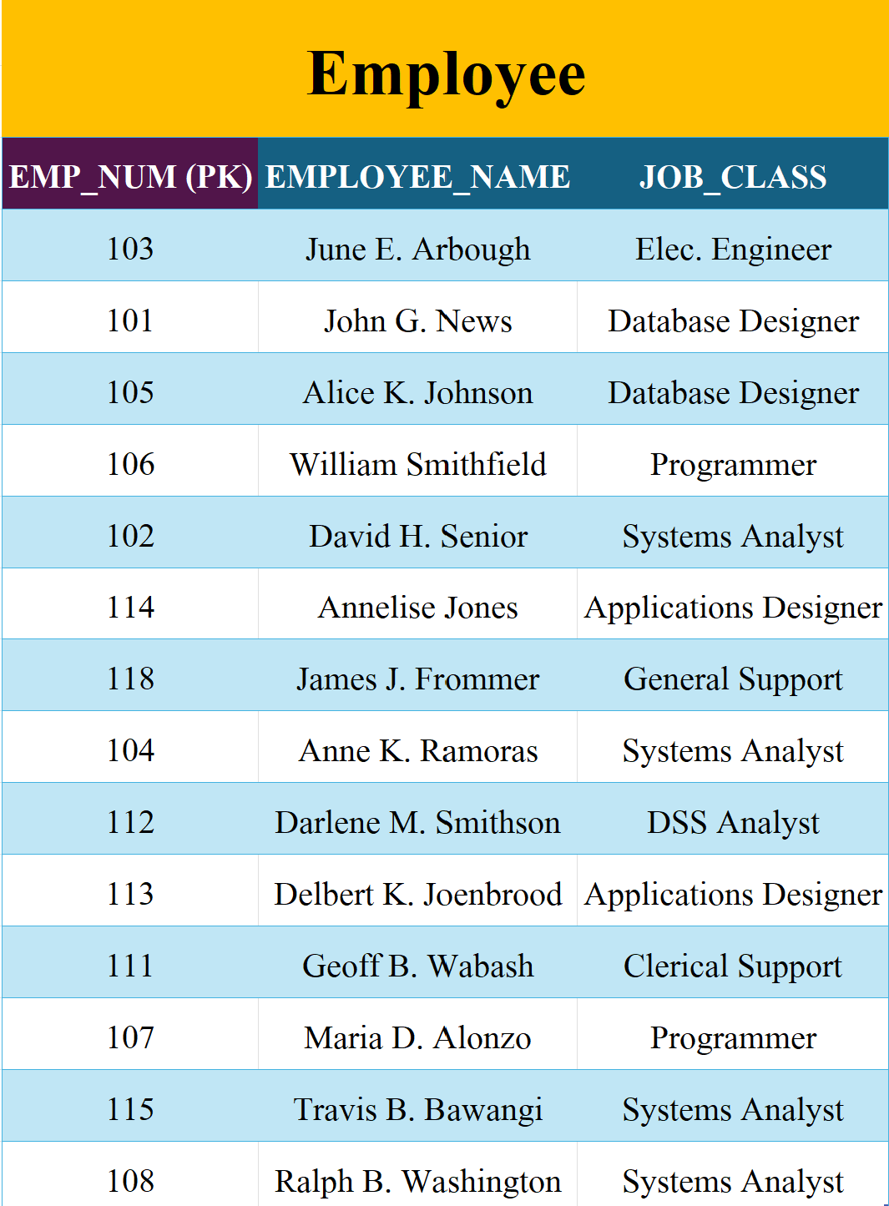
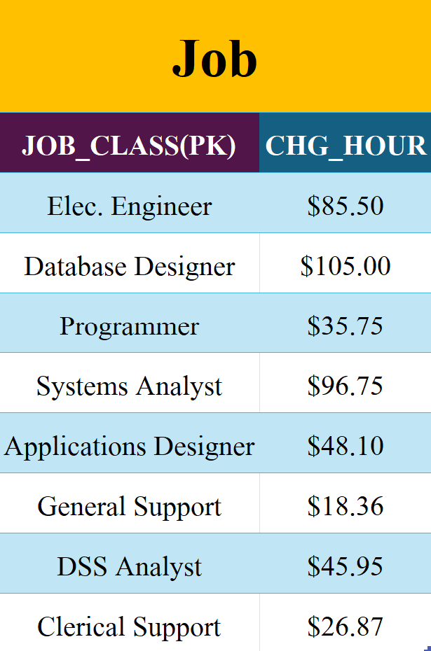
3NF

Slide 13
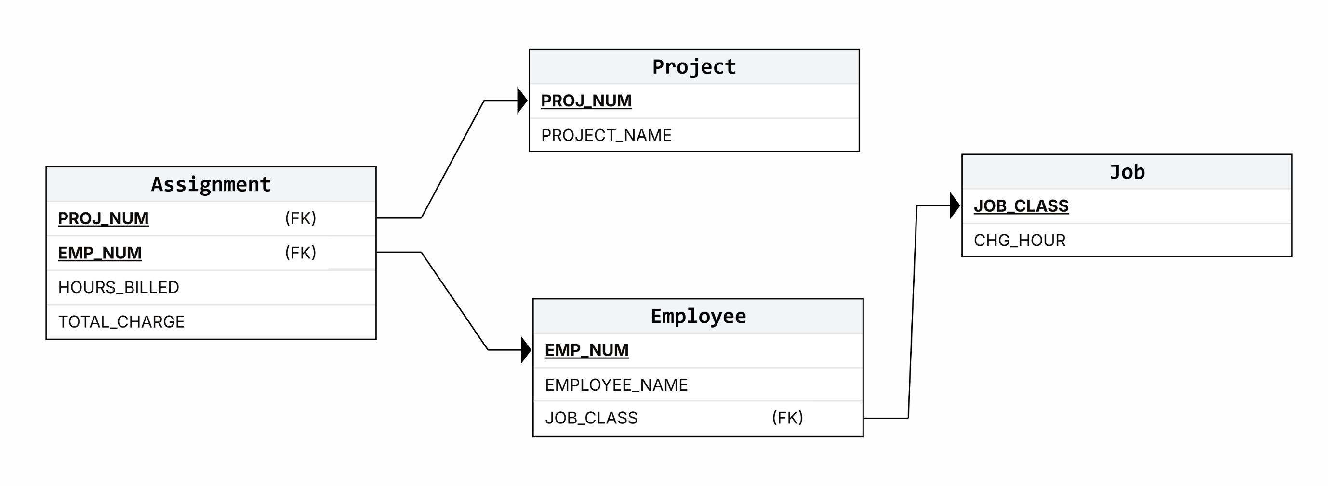
Mapping

